Slide 1
Morkov Decision Processes

Slide 2
Overview
Decision processes and Markov Decision Processes (MDP)
Rewards and Optimal Policies
Defining features of Markov Decision Process
Solving MDPs
Value Iteration
Policy Iteration
POMDPs

Slide 3
Rewiew: Decisions Under Uncertainty
Some areas of AI (e.g., planning) focus on decision making in domains where the environment is understood with certainty
Here we focus on an agent that needs to make decisions in a domain that involves uncertainty
An agent’s decision will depend on:
what actions are available. They often don’t have deterministic outcome
what beliefs the agent has over the world
the agent’s goals and preferences

Slide 4
Decision Processes
We focus on situations that involve sequences of decisions
The agent decides which action to perform
The new state of the world depends probabilistically upon the previous state as well as the action performed
The agent receives rewards or punishments at various points in the process
The agent’s utility depends upon the final state reached, and the sequence of actions taken to get there
Aim: maximize the reward received

Slide 5
Markov Decision Processes (MDP)
For an MDP you specify:
set S of states, set A of actions
Initial state s₀
the process’ dynamics (or transition model)
P(s'|s,a)
The reward function
R(s, a,, s’)
describing the reward that the agent receives when it performs action a in state s and ends up in state s’
We will use R(s) when the reward depends only on the state s and not on how the agent got there

Slide 6
Planning Horizons
The planning horizon defines the timing for decision making
Indefinite horizons: the decision process ends but it is unknown when
In the previous example, the process ends when the agent enters one of the two terminal (absorbing) states
Infinite horizons: the process never halts
e.g. if we change the previous example so that, when the agent enters one of the terminal states, it is flung back to one of the two left corners of the grid
Finite horizons: the process must end at a specific time N
We focus on MDPs with infinite and indefinite horizons

Slide 7
Information Availability
What information is available when the agent decides what to do?
Fully-observable MDP (FOMDP):
the agent gets to observe current state s_{t} when deciding on action a_{t} .
Partially-observable MDP (POMDP)
the agent can’t observe s_{t} directly, can only use sensors to get information
We only look at FOMDP (but we will call them simply MDPs)

Slide 8
Reward Function
Suppose the agent goes through states s₁, s₂,...,s_{k} and receives rewards r₁, r₂,...,r_{k}
We will look at discounted reward to define the reward for this sequence, i.e. its utility for the agent

Slide 9
Solving MDPs
In search problems, aim is to find an optimal state sequence
In MDPs, aim is to find an optimal policy π(s)
A policy π(s) specifies what the agent should do for each state s
Because of the stochastic nature of the environment, a policy can generate a set of environment histories (sequences of states) with different probabilities
Optimal policy maximizes the expected total reward, where the expectation is take over the set of possible state sequences generated by the policy
Each state sequence associated with that policy has a given amount of total reward
Total reward is a function of the rewards of its individual states (we’ll see how)

Slide 10
More formally
A stationary policy is a function:
For every state s, л(s) specifies which action should be taken in that state.
Utility of a state
Defined as the expected utility of the state sequences that may follow it
These sequences depend on the policy л being followed, so we define the utility of a state s with respected to л (a.k.a value of л for that state) as
Where S_{i} is the random variable representing the state the agent reaches after executing л for i steps starting from s

Slide 11
More Formally (cont.)
An optimal policy is one with maximum expected discounted reward for every state.
A policy л* is optimal if there is no other policy л’ and state s such as
U^{п’}(s) > U^{п*}(s)
That is an optimal policy gives the Maximum Expected Utility (MEU)
For a fully-observable MDP with stationary dynamics and rewards with infinite or indefinite horizon, there is always an optimal stationary policy.

Slide 12
Value Iteration
Algorithm to find an optimal policy and its value for a MDP
The idea is to find the utilities of states, and use them to select the action with the maximum expected utility for each state

Slide 13
Value Iteration: from state utilities to л*
Remember that we defined the utility of a state s as the expected sum of the possible discounted rewards from that point onward
We define U(s) as the utility of state s when the agent follows the optimal policy л* from s onward (i. e., U ^{л*}(s))
aka value of л*

Slide 14
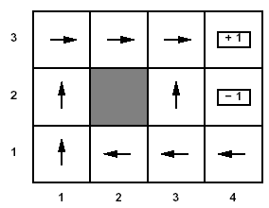
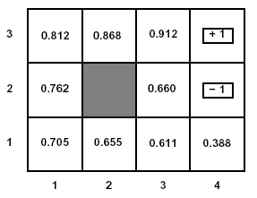
U(s) and R(s)
Note that U(s) and R(s) are quite different quantities
R(s) is the short term reward related to s
U(s) is the expected long term total reward from s onward if following л*
Example: U(s) for the optimal policy we found for the grid problem with R(s non-terminal) = -0.04 and γ =1

Slide 15
Value Iteration: from state utilities to л*
Now the agent can chose the action that implements the MEU principle: maximize the expected utility of the subsequent state
expected value of following policy л* in s’
states reachable
from s by doing a
Probability of getting to s’ from s via a

Slide 16
Example
To find the best action in (1,1)

Slide 17
Example
To find the best action in (1,1)

Slide 18
Example
To find the best action in (1,1)

Slide 19
Example
To find the best action in (1,1)
Plugging in the numbers from the game state above, give Up as best action

Slide 20
Finding Utilities
Great, but how do we find the utilities?
Value iteration exploits the relationship between the utility of a state and the utility of its neighbours
So the utility of following the optimal policy in s is
Reward sequences for the states reached by following the optimal action in s_{k}
Immediate reward for s
Expected utility of state s’ reached by action a in s

Slide 21
Finding Utilities
Given N states, we can write an equation like the one below for each of them
Each equation contains N unknowns – the U values for the N states
N equations in N variables (Bellman equations)
It can be shown that they have a unique solution: the values for the optimal policy
Unfortunately the N equations are non-linear, because of the max operator
Cannot be easily solved by using techniques from linear algebra
Value Iteration Algorithm
Iterative approach to find the optimal policy and corresponding values

Slide 22
Value Iteration: General Idea
Let U^{(i)}(s) be the utility of state s at the i^{th} iteration of the algorithm
Start with arbitrary utilities on each state s: U⁽⁰⁾(s)
Repeat simultaneously for every s until there is “no change”
True “no change” in the values of U(s) from one iteration to the next are guaranteed only if run for infinitely long.
In the limit, this process converges to a unique set of solutions for the Bellman equations
They are the total expected rewards (utilities) for the optimal policy

Slide 23
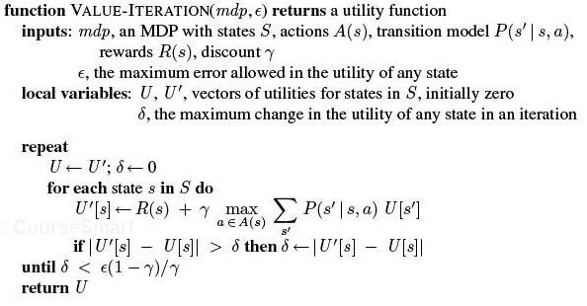
VI algorithm

Slide 24
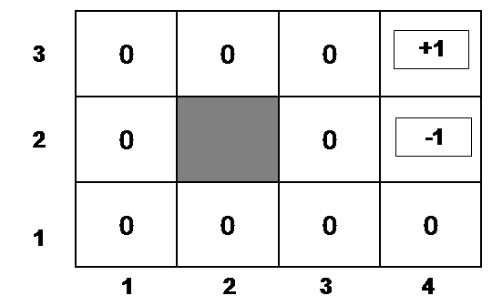
Example
Suppose, for instance, that we start with values U⁽⁰⁾(s) that are all 0
Iteration 0
Iteration 1
3
2
1
0 | 0 | 0
0 |  | 0
0 | 0 | 0 | 0
+1
-1
-0.04
1 2 3 4

Slide 25
Example (cont’d)
Let’s compute U⁽¹⁾(3,3)
Iteration 0
Iteration 1
3
2
1
0 | 0 | 0
0 |  | 0
0 | 0 | 0 | 0
0.76
+1
-1
-0.04
-0.4
1 2 3 4

Slide 26
Example (cont’d)
Let’s compute U⁽¹⁾(4,1)
Iteration 0
Iteration 1
3
2
1
0 | 0 | 0
0 |  | 0
0 | 0 | 0 | 0
.76
+1
-1
-0.04
-0.04
1 2 3 4

Slide 27
After a Full Iteration
Iteration 1
3
2
1
-.04 | -.04 | 0.76
-.04 |  | -.04
-.04 | -.04 | -.04 | -.04
+1
-1
1 2 3 4
Only the state one step away from a positive reward (3,3) has gained value, all the others are losing value because of the cost of moving

Slide 28
Some steps in the second iteration
Iteration 1
Iteration 2
3
2
1
-.04 | -.04 | 0.76
-.04 |  | -.04
-.04 | -.04 | -.04 | -.04
3
2
1
-.04 | -.04 | 0.76
-.04 |  | -.04
-.04 | -.04 | -.04 | -.04
+1
+1
-1
-1
-0.08
1 2 3 4
1 2 3 4

Slide 29
Example (cont’d)
Let’s compute U⁽¹⁾(2,3)
Steps two moves away from positive rewards start increasing their value
Iteration 2
Iteration 1
-.04 | -.04 | 0.76
-.04 |  | -.04
-.04 | -.04 | -.04 | -.04
0.56
+1
3
2
1
-.04 | -.04 | 0.76
-.04 |  | -.04
-.04 | -.04 | -.04 | -.04
+1
-1
-1
-0.08
1 2 3 4
1 2 3 4

Slide 30
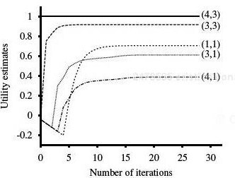
State Utilities as Function of Iteration #
Note that utilities of states at different distances from (4,3) accumulate negative rewards until a path to (4,3) is found

Slide 31
Policy Iteration
We saw that we can obtain an optimal policy even when the U function returned by value iteration is not optimal yet
Intuitively, if one action is clearly better than all others, the precise utilities of the states involved are not necessary to select it
This is the intuition behind the policy iteration algorithm

Slide 32
Policy Iteration
Algorithm
π_{i} ← an arbitrary initial policy, U ← A vector of utility values, initially 0
2. Repeat until no change in π
Compute utilities U^{i} generated by executing π_{i} with current U (policy evaluation)
(b) Compute a new MEU π_{i+1} using a one-step look-ahead based on U^{i} (policy improvement)
Watch out, there is no “MAX” here, because the policy is already fixed!
Here there is “MAX” because we need to find out whether there is any other action that does better then the action specified by π_{i}

Slide 33
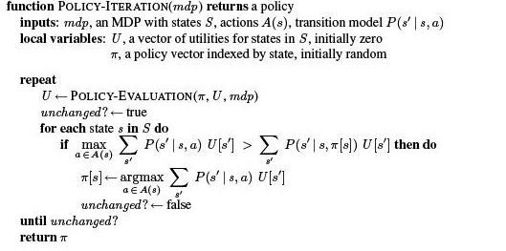
Policy Iteration

Slide 34
Policy Iteration

Slide 35
Policy Iteration

Slide 36
Policy Iteration

